Slide 1

Adidas Sales Data Analysis
using MS Excel and
MS Power BI

Slide 2

Objective :
Adidas wants to create an annual sales and profits report for 2020 and 2021. So that, Adidas can understand their sales and profit and grow more sales as well profit in future.

Slide 3


Requirements of Adidas
Which are the top 5 cities which contributing maximum sales?
Which month got the highest profit?
Which are the states contributing highest Sale?
Compare the retailers according the sales and profit.
Provide the region wise profit and sale.
Which product contributed maximum sale?
Which are the states contributing highest Profit?
Which sell method is more contributing maximum sale?
Finally provide the sale forecast for 15 days.

Slide 4

Steps:
Data Cleaning
Data Processing
Data Analysis
Data Visualization
Reports
Insights

Slide 5
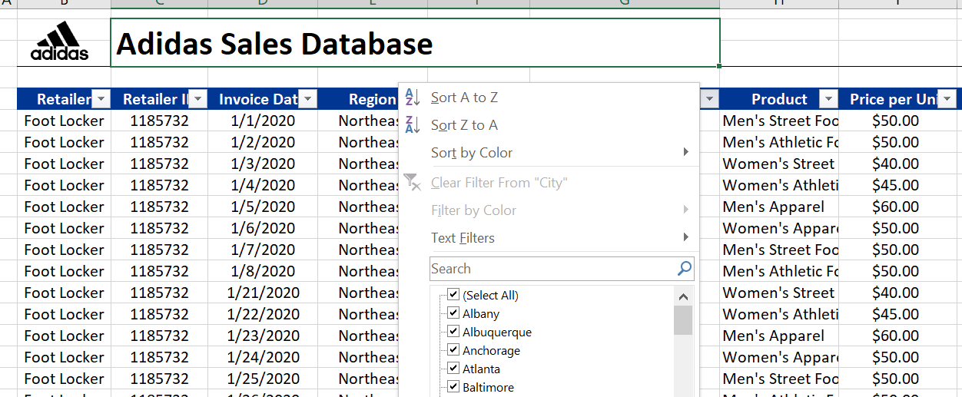
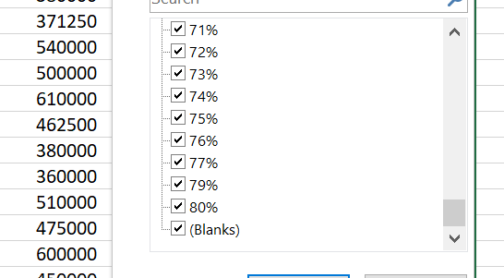
1. Data cleaning
We have cleaned the dataset by removing null values using filter option.
Also we have checked duplicate values.
We prepared data in a specific manner.

Slide 6
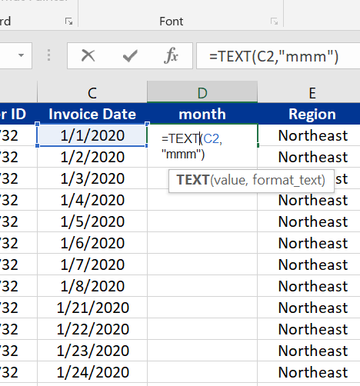
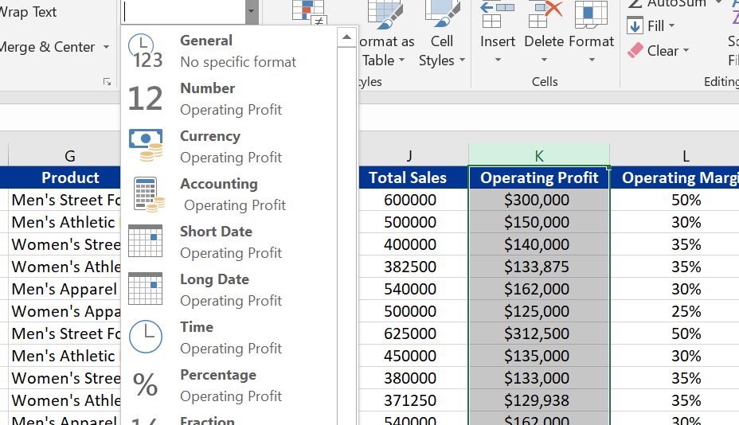
We have created some necessary column “Month” by using formula.
Also we converted data in specific manner.
2. Data Processing

Slide 7
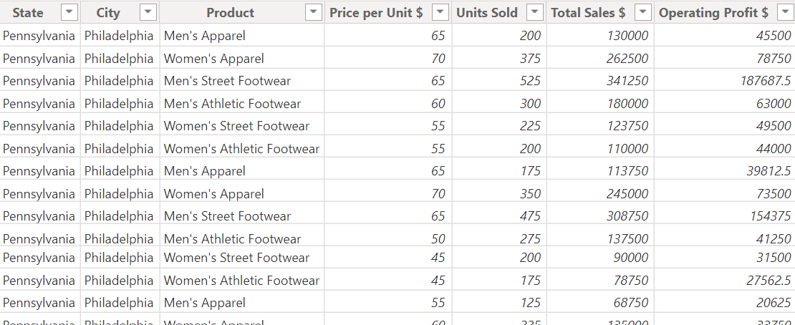




3. Data Analysis
We analyzed the data and we concluded the target variables are “Total sales” and “operating Profit”.

Slide 8

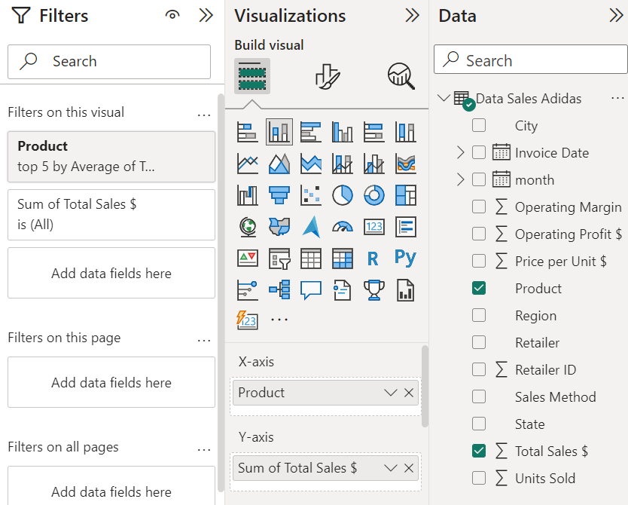
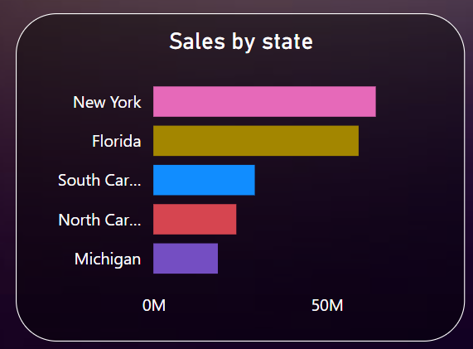
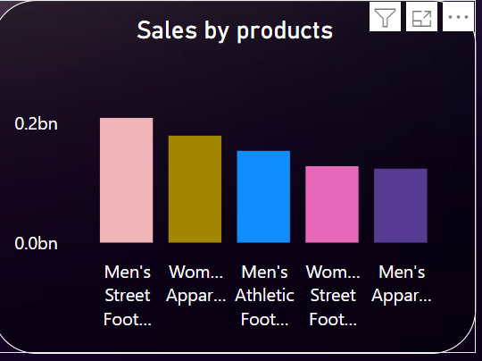
4. Data Visualization
We visualized the data with target variables.

Slide 9
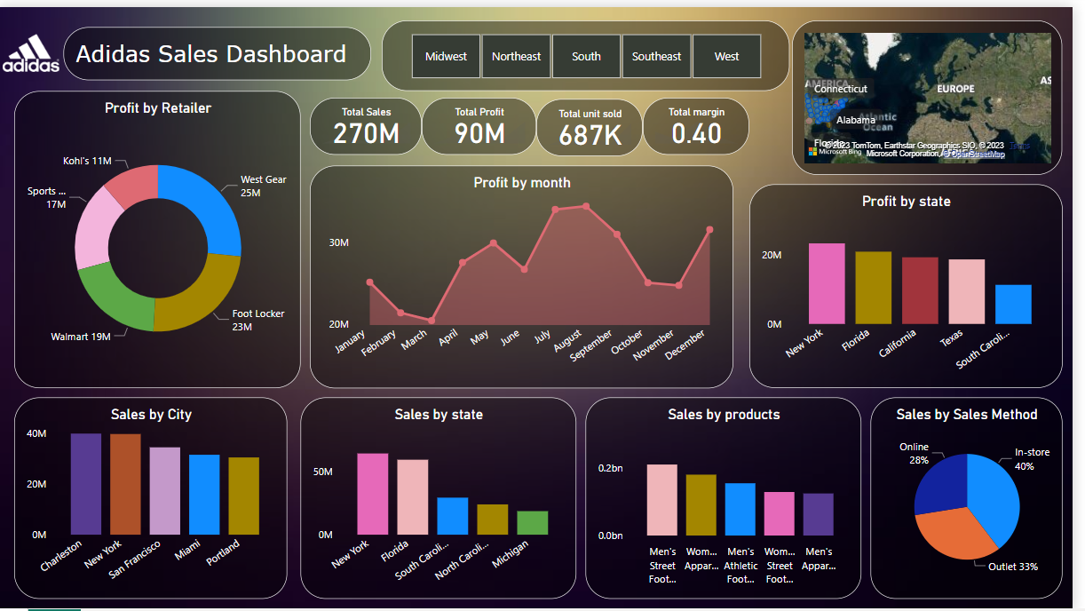
5. Reports
Finally we created insight-full Dashboard by using power BI

Slide 10
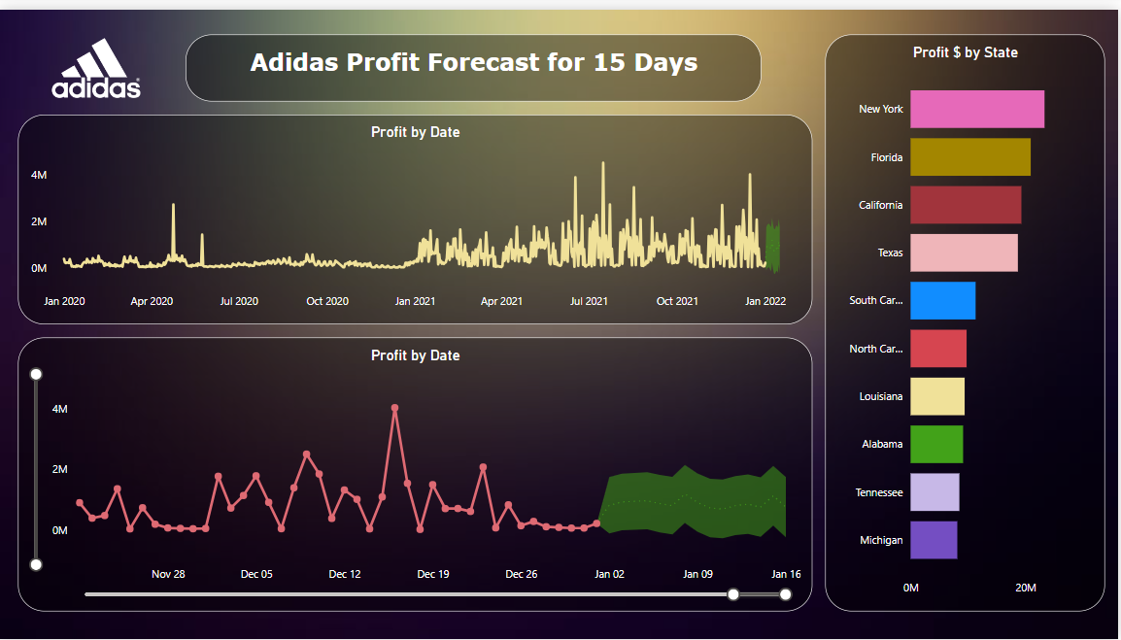
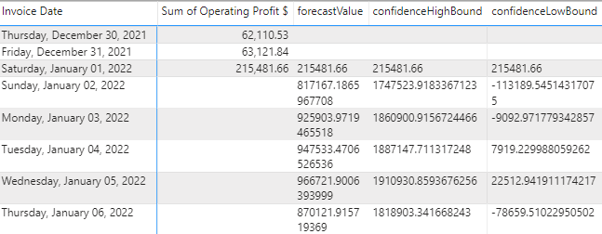
Adidas Profit Forecast for !5 Days
We created profit forecasting for 15 days that from 1st January to 15th January .

Slide 11
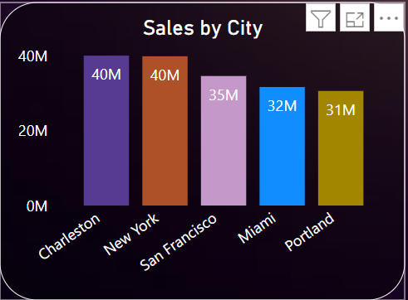
6. Insights
1)Top 5 cities which contributing maximum sales which are namely as
1.Charleston 2.New York 3.San Francisco 4. Miami 5.Portland.

Slide 12
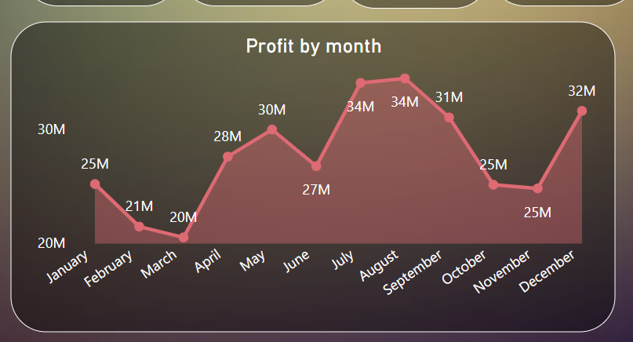
2. August and July months got the highest profit which is 34 Million $ for each.

Slide 13
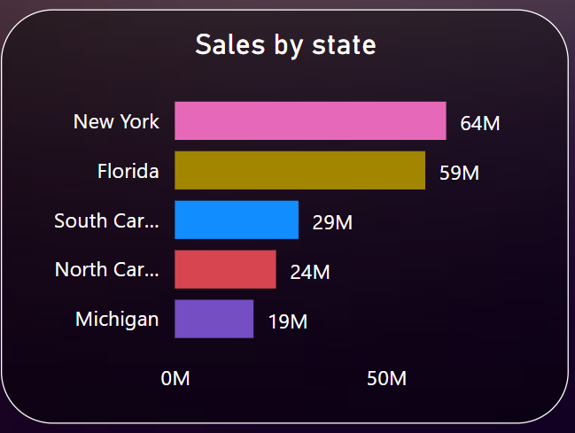
3.Following states contributing highest Sale
1.New York 2.Florida 3.South Carolina 4. North Carolina 5.Michigan

Slide 14
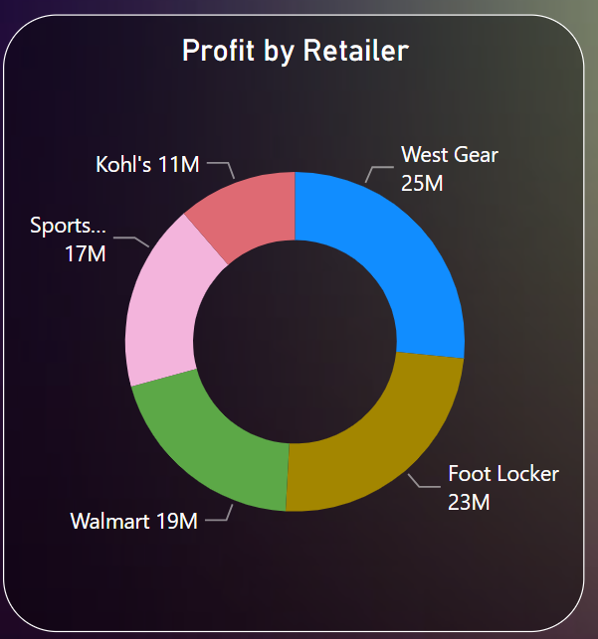
4. The following Retailers are more contributing in sale as well profit.
As we can see here West Gear and Foot Locker are more contributing in Sale as well Profit.

Slide 15

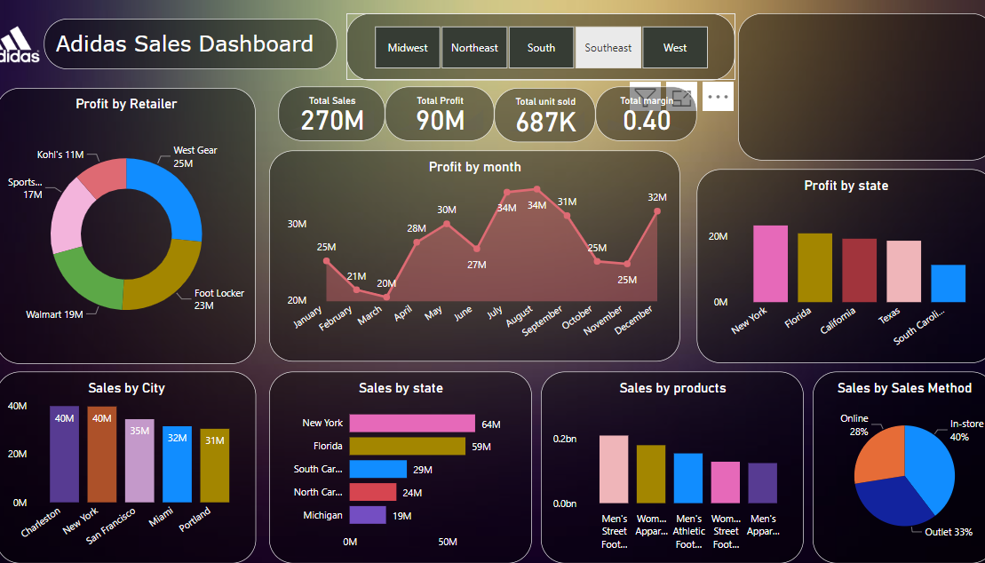
5.Region wise profit and sale.
As we can see in slicers there we mentioned all the regions on clicking on them we can see all sale and profit by the region.

Slide 16
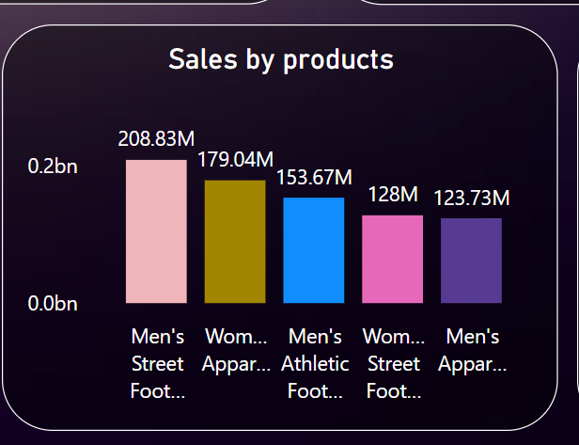
6.product contributed maximum sale – Men’s Street Footwear with 208.83 M annual sale.

Slide 17
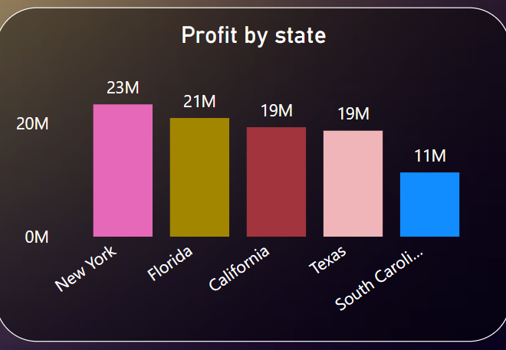
7.Following states contributing highest Profit 1. New York 2.Florida 3.California 4.Texas 5.South Carolina

Slide 18
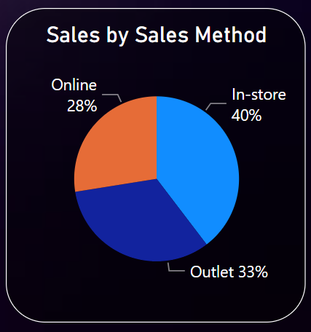
8.“In-store” sale method is more contributing maximum sale

Slide 19
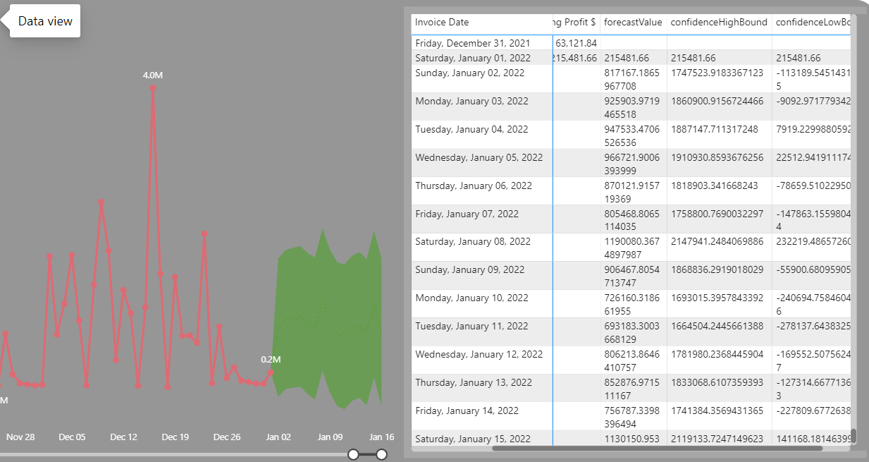
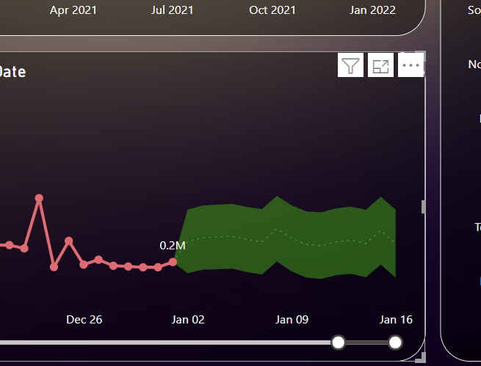
9.Finally we provided the sale forecast for 15 days.

Slide 20

Thank You

